Slide 1
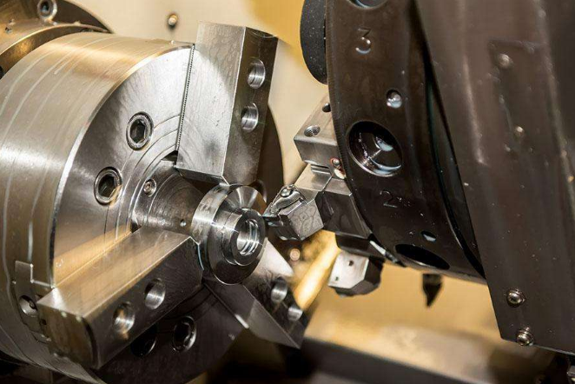
Acoustic Emission Monitoring and Alarm System for Machine Tool Status
QingCheng AE Institute(Guangzhou) Co.,Ltd
www.aendt.com
sales@ae-ndt.com

Slide 2
01
Brief
02
Solution
Contents
Introduction of hardware and software
03
04
Service Cases
05
Benefit evaluation
06
Conclusion

Slide 3
01
Brief

Slide 4
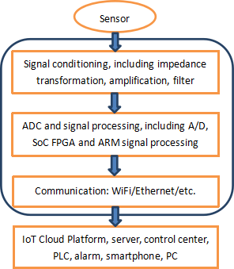
01
Brief -- Theory
The acoustic wave emitted by the tool machining process reflects the tool wear state, and the AE sensor receives the acoustic wave and analyzes the tool wear state by signal acquisition and processing system.
Preamp
Signal acquisition and processing system
Recording and display system
AE sensor
Wave propagation
*
Tool and workpiece wear signal source

Slide 5
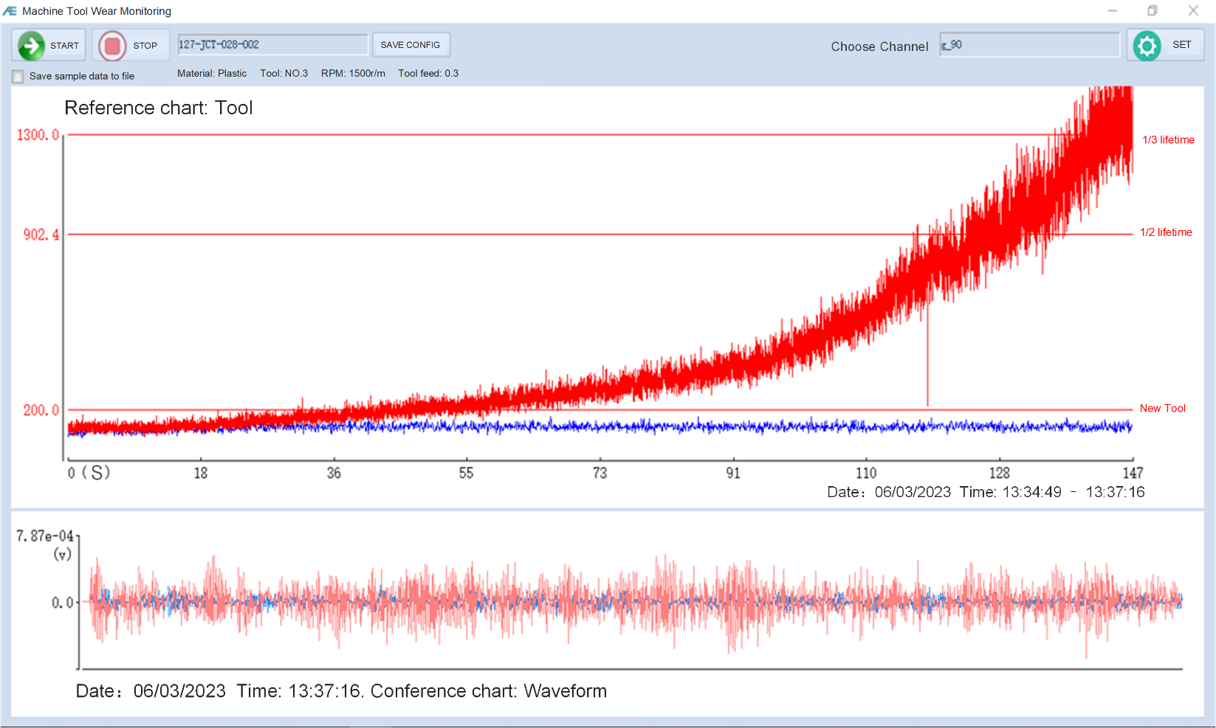
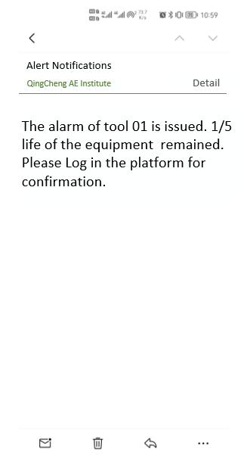
01
Brief – Application Result
Real-time and historical data display on screen though online monitoring software
Alarm push

Slide 6
02
Solution

Slide 7
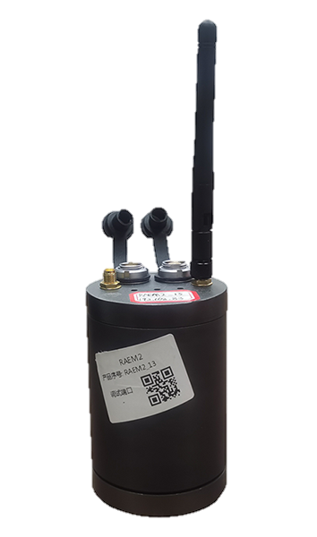
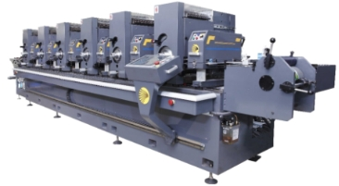
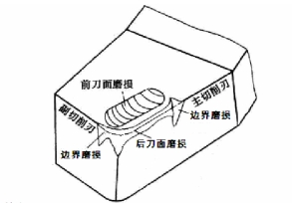
02
Solution-- RAEM series remote AE monitoring system
Acoustic emission technology was applied on tool condition monitoring to extend tool life and eliminate workpiece damage caused by tool wear.
24/7 online monitoring and detection, the whole process of automatic analysis results, Internet of Things remote operation and use, mobile phone alarm push.
（ Historical data can also be queried, all tool status and the
occurrence of failure time could be observed. ）

Slide 8
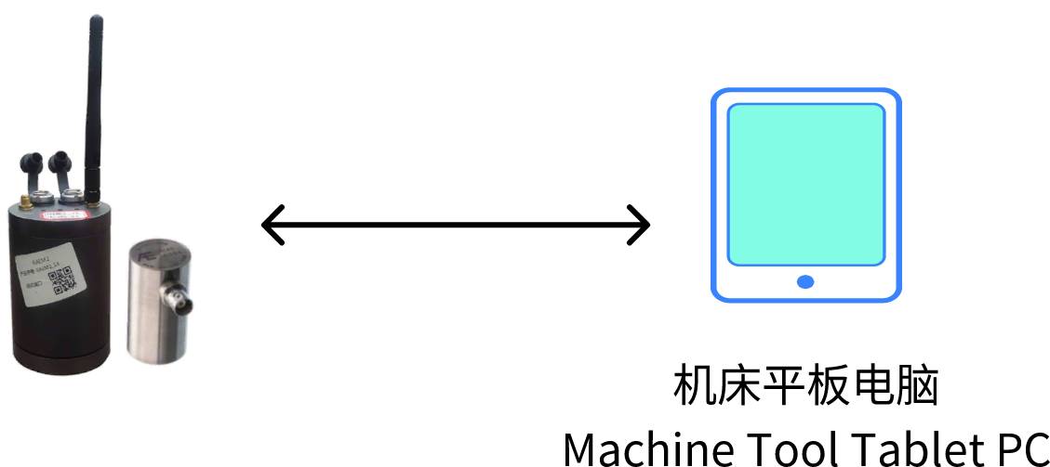
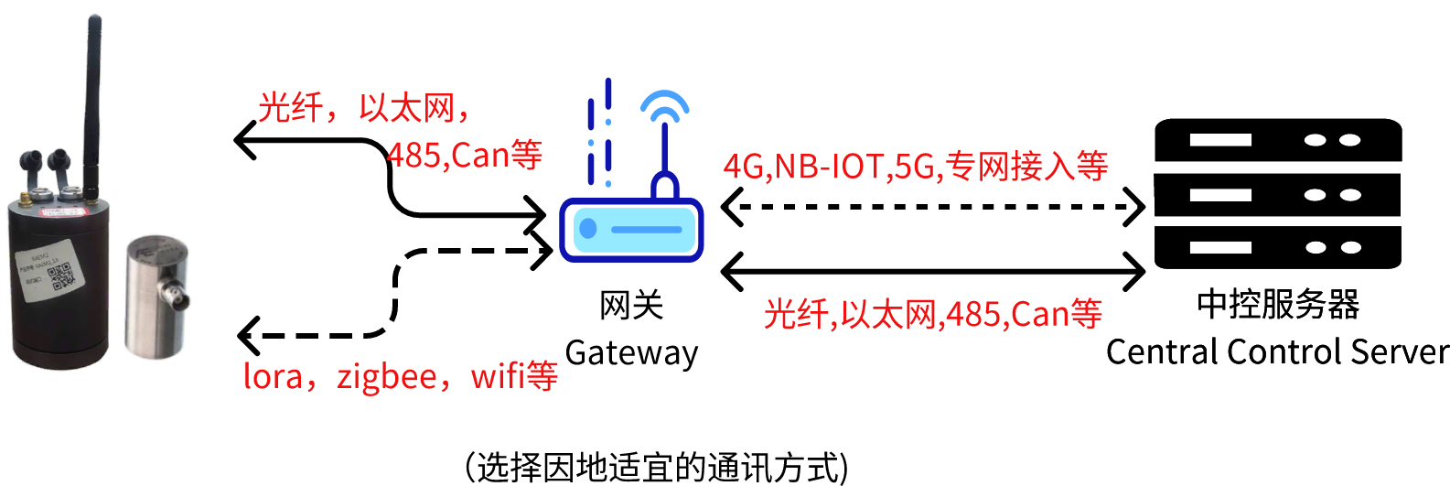
02
Solution-- 4 systems and communication modes
Operation and display on-site
Operation and display in control room
Remote network
communication system
Remote networking communication system
Note: The above systems have the functions of mobile app Bluetooth communication inspection and field debugging setting.

Slide 9
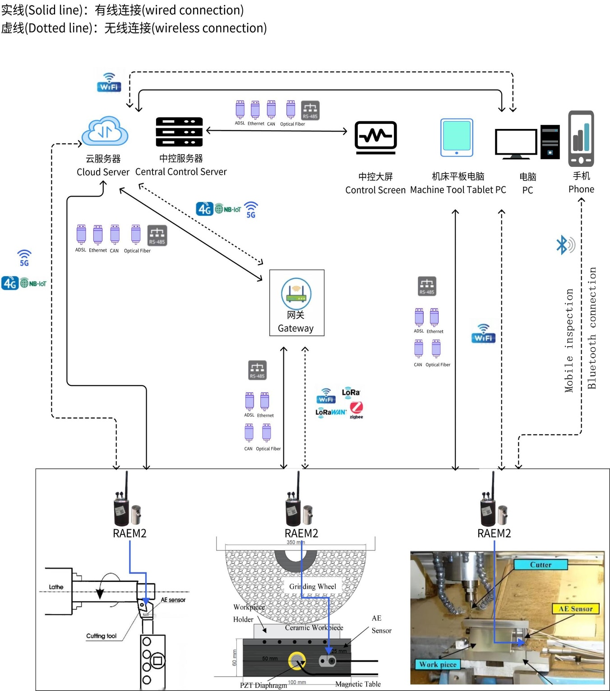
RAEM2
system general diagram

Slide 10
Introduction of hardware and software
03

Slide 11
03
Introduction of hardware and software
RAEM1 Collector
RAEM2 Collector
Signal trigger and time trigger
Transient signal and continuous signal acquisition
Long-term monitoring and diagnosis
Intelligent acoustic emission collector integrating signal acquisition, signal analysis and communication data output
Time trigger
Continuous signal acquisition
Long-term monitoring and diagnosis
Low power consumption and low cost
Intelligent acoustic emission collector integrating signal acquisition, signal analysis and communication data output

Slide 12
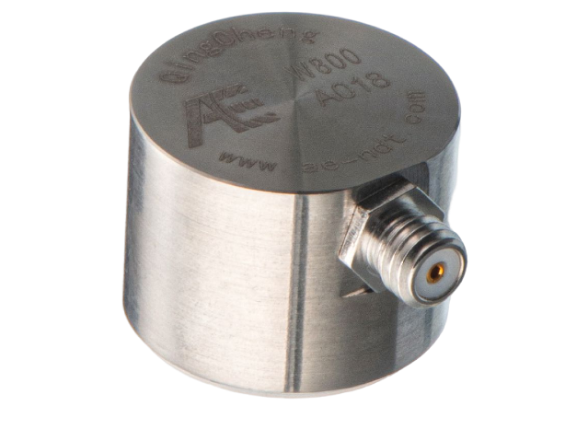
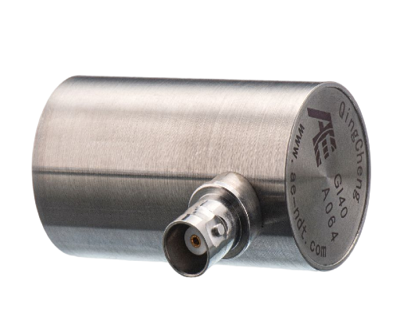
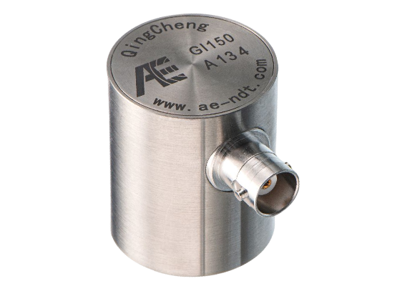
03
Introduction of hardware and software
AE sensors
Convert mechanical signals into electrical signals and transmit signals to acoustic emission acquisition and analysis system
W800
GI40
GI150

Slide 13
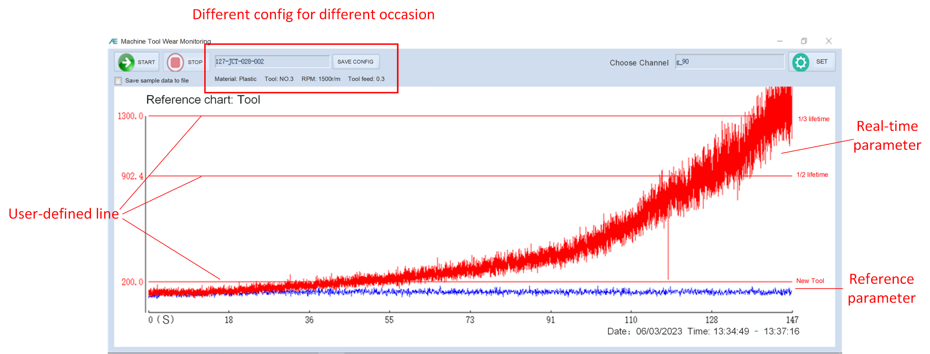
03
Introduction of hardware and software
Software
Setup appropriate alarm criteria According to different processing materials, different cutting tools, different speed, different feed amount;
Display the difference between normal tool view and real-time view, easy to observe the current tool state.

Slide 14
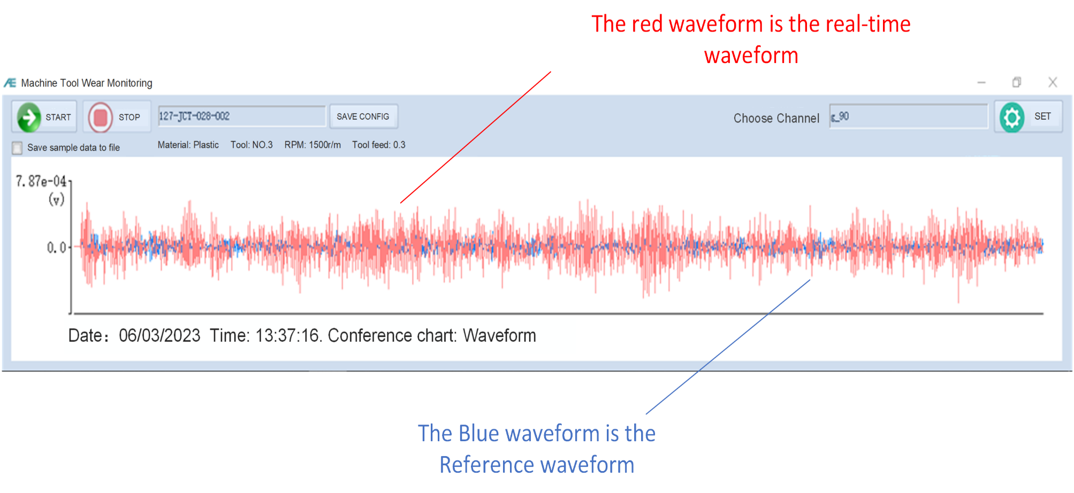
03
Introduction of hardware and software
Software
Acoustic emission parameters and waveform data could be switched freely
user can grasp the tool wear process macroscopically and view details microscopically.。

Slide 15
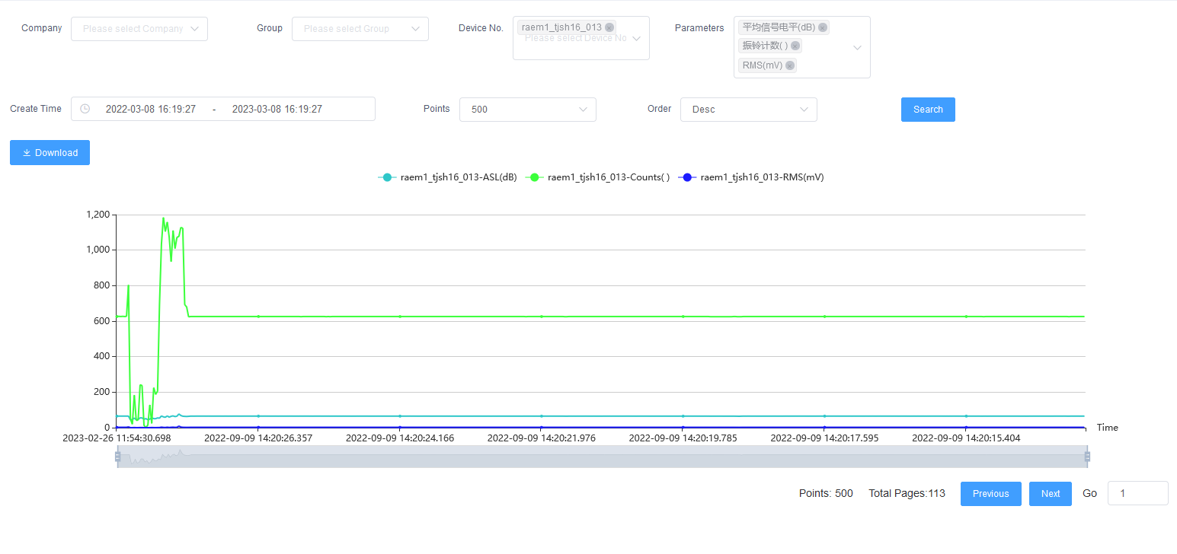
03
Introduction of hardware and software
Cloud monitoring software (cloud platform)
The data can be uploaded to Qingcheng Internet of Things cloud platform, Ali Cloud platform, Amazon cloud platform, etc., and can also be customized and uploaded to the user server according to user needs.

Slide 16
Technical parameter
RAEM2
Channel | Single channel | Sampling accuracy | 16-bit
Trigger method | Time trigger | System noise | <30dB
Sampling rate | Max.2M/s per channel | Dynamic range | 70dB
Protect grade | IP65 | Input bandwidth | 10KHz-800KHz
Digital filter | Any value within 0KHz~1000KHz can be set freely, high pass, low pass, band pass
Sensor | Integral sensors with built-in preamplifier (Choose one of three preamp options when ordering: 40dB28V, 34dB12V or 26dB5V)
Data output | Waveform, AE parameters and parameter rating
AE parameter | Amplitude, energy, RMS，ASL
SD card | 64G（can be expanded up to 512G）
Comm method | 4G、network port、Wi-Fi、RS485（customized with NB-IOT, Lora etc.）
Working temp. | -20℃~60℃（Wi-Fi version: 0℃~60℃）
Power supply | Battery or external power supply (DC 12V)
Size (D x H) | 62mm x 50-120mm (customized)
Installation | Magnetic base, can be adsorbed on the surface of the metal object

Slide 17
Technical parameter
RAEM1
Channel | Single channel | Sampling accuracy | Sampling accuracy | 16-bit | 16-bit
Trigger method | Threshold/time trigger | System noise | System noise | <30dB | <30dB
Sampling rate | Max.2M/s per channel | Dynamic range | Dynamic range | 70dB | 70dB
Protect grade | IP65 | Input bandwidth | Input bandwidth | 10KHz-800KHz | 10KHz-800KHz
Analog filter | High-pass filters: 30KHz, 125KHz Low-pass filter： 80KHz, 175KHz
Digital filter | Any value within 0KHz~1000KHz can be set freely, high pass, low pass, band pass
Sensor | Integral sensors with built-in preamplifier (Choose one of three preamp options when ordering: 40dB28V, 34dB12V or 26dB5V)
Data output | Waveform, AE parameters and parameter rating
AE parameter | Arrival time, amplitude, counts, energy, rise time, duration，RMS，ASL
SD card | 64G（can be expanded up to 512G）
Comm method | 4G、network port、Wi-Fi、RS485（customized with NB-IOT, Lora etc.）
Working temp. | -20℃~60℃（Wi-Fi version: 0℃~60℃）
Power supply | Battery or external power supply (DC 12V) |  | Weight |  | 220g (without built-in battery/sensor)
Size (D x H) | 62mm x 100mm (without built-in battery/sensor)
Installation | Magnetic base, can be adsorbed on the surface of the object

Slide 18
04
Service Cases
Implement acoustic emission on-line monitoring for a tool of a machine tool

Slide 19
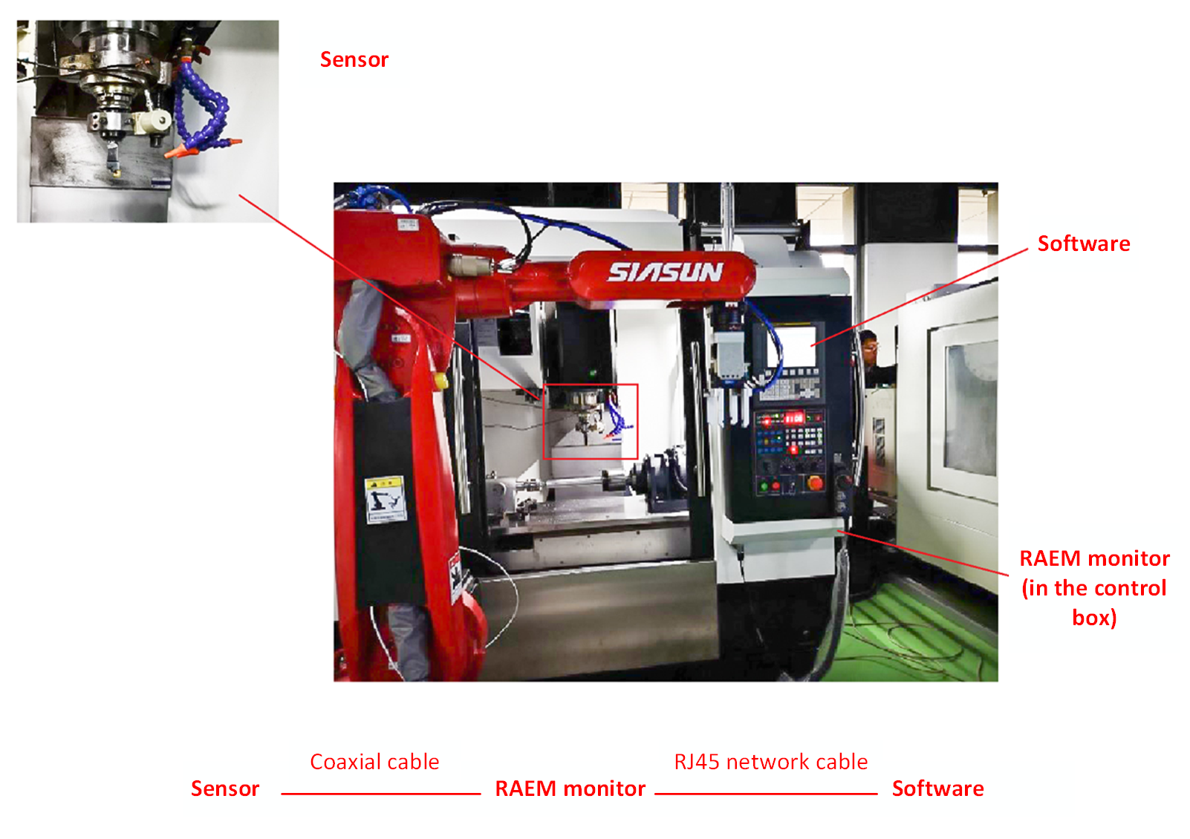
04
Service Cases
1. Hardware layout: the integral preamp sensor is arranged to the appropriate position of the tool, and is connected to the RAEM1 collector through coaxial cable, and the collector is connected to the upper computer software of the field control computer through network cable.

Slide 20
04
Service Cases
2. Open the tool wear software and click Sample Settings to enter the setting screen. Set the Sample mode and save the Settings. In this example, 10s are collected per hour.

Slide 21
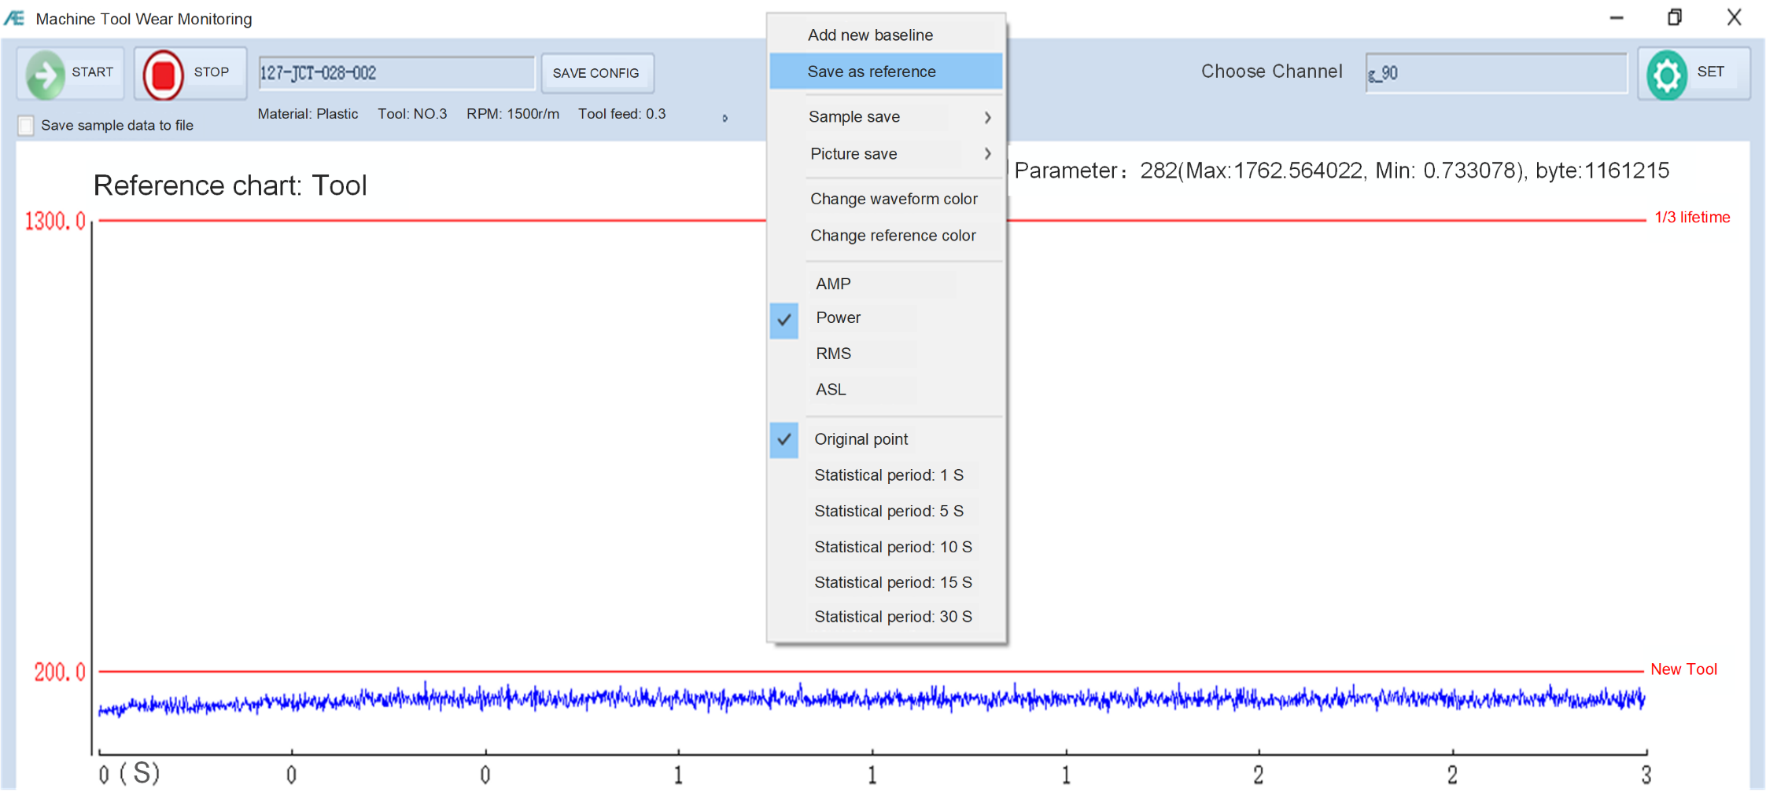
04
Service Cases
3. Click START and use the new tool to collect data for a period of time, select the appropriate parameter graph (power is selected here) for judgment, and save the graph as the benchmark graph of the new tool.

Slide 22
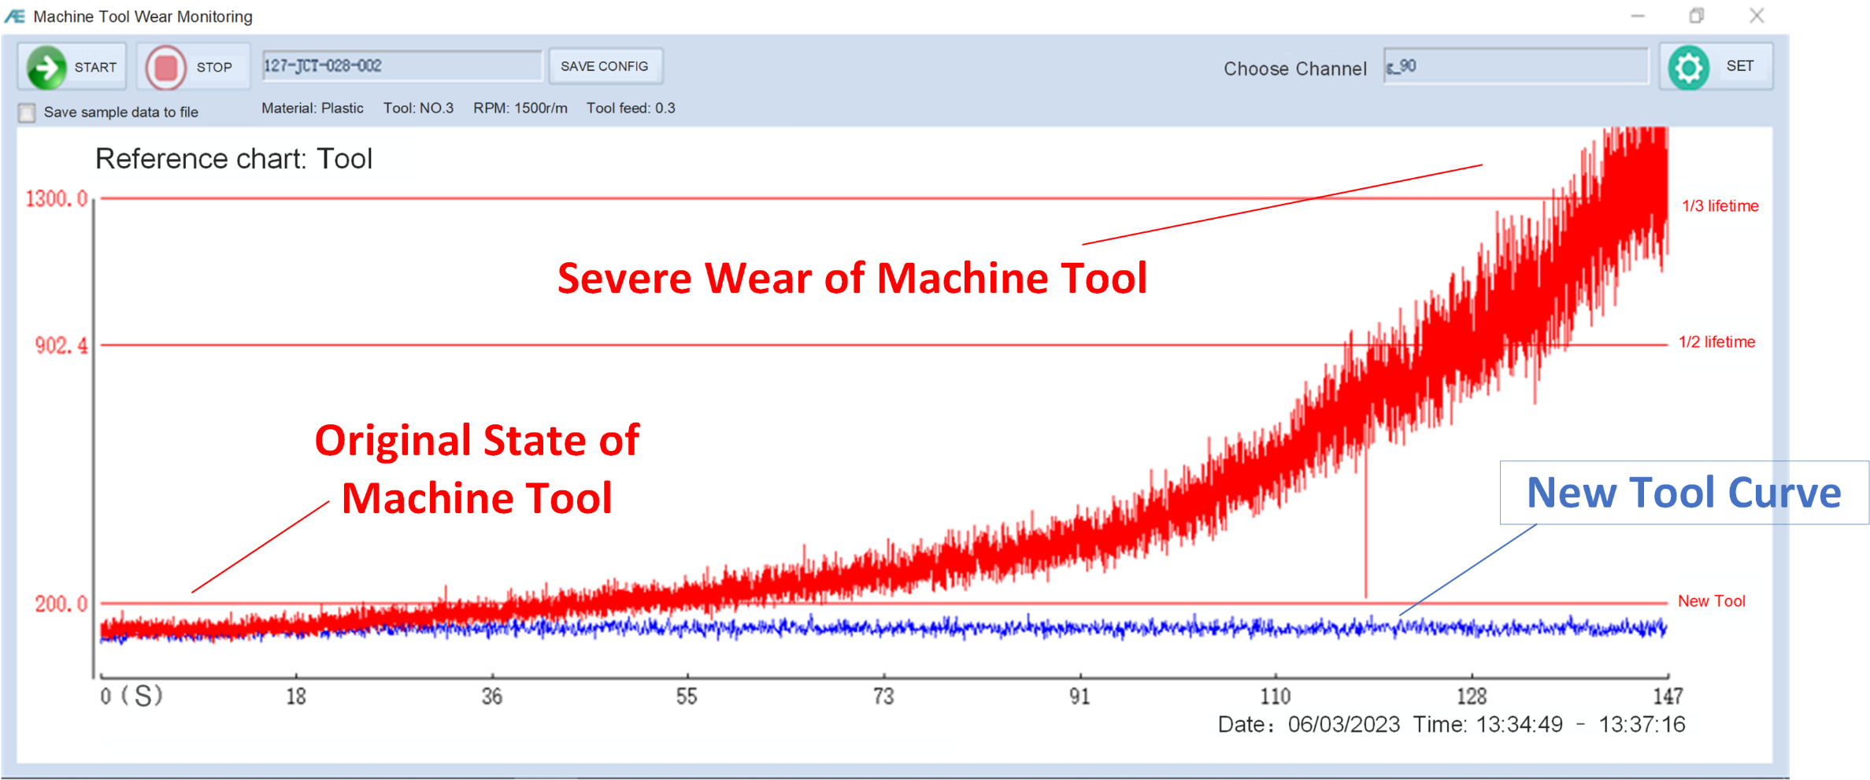
04
Service Cases
4. After a period of time, the tool reaches the state of serious wear, and the signal value rises to a certain height. At this time, set the warning line. Save the current configuration and call this setting directly later in the same situation.

Slide 23
04
Service Cases-- Acquisition process video
Acquisition process video (click display).

Slide 24
05
Benefit evaluation

Slide 25
05
Benefit evaluation
Machine Tool Market
In 2021, the total consumption scale of the tool market increased from 42.1 billion yuan in 2020 to 47.7 billion yuan in 2021, with a year-on-year growth of 13.3%; Hit a new high.
In the first half of 2022, the export value of cutting tools was 11.24 billion yuan, up 8% year-on-year, while the import value was 4.864 billion yuan, down 10.69% year on year. [2]
[2] Import and export Customs data and analysis of tools (cutting tools, measuring tools, measuring instruments) in the first half year of 2022, Secretariat of Tool Branch of China Machine Tool Industry Association

Slide 26
05
Benefit evaluation
Disadvantages of tool industry
Research shows that tool wear is the root cause of tool failure.
The maintenance cost caused by tool failure accounts for 15% ~ 40%
^{of the cost of goods produced.}
The maintenance cost caused by tool failure accounts for 20%
of the cost of production goods. [1]
[1] Zhang Kai, Quan Yu, Liu Changfu, Yan Yongfei, Zhou Yang, Yang Bohan. Research status and Development Trend of intelligent Tool Wear Monitoring Method [J]. Metal Working (Cold Working),2022(09):8-14.

Slide 27
05
Benefit evaluation
The following benefits can be expected from the use of this system
Avoid replacing the tool in advance, so that the overall service life of the tool is extended
The probability of workpiece being processed into waste products is greatly reduced because the cutting tool is not replaced in time
Accurately judge the state of the tool during the tool processing, without disassembly inspection and rough judgment of the human eye
By alarm function timely replacement, alarm process is more scientific.
Effectively reduce manual maintenance costs

Slide 28
06
Conclusion

Slide 29
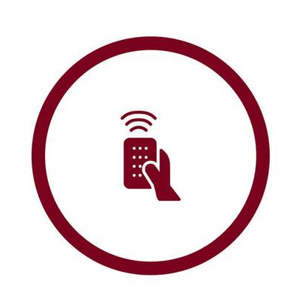
06
Conclusion/advantage
On-line
Intelligent
Remote
The collector is installed on the objects to be monitored and diagnosed. The collector monitors and diagnoses 24/7.
The monitoring and diagnosis results are automatically given without manual data analysis and processing and manual operation. The data acquisition and analysis report shows the whole monitoring and diagnosis process automatically.
With the help of the Internet of Things system, the monitoring and diagnosis results of any monitoring and diagnosis points at any location with no limit of distance can be obtained.
(including online real-time results and historical process results)

Slide 30
Customizable development functions
Communication alarm
Function upgrade
Database
The built-in functions of the software are continuously optimized and can be customized according to the needs of cooperation.
Establish machine tool database, judge tool state reasonably by existing data.
Mobile phone remote Bluetooth communication configuration and fault monitoring, cloud platform customized alarm push mode.

Slide 31
Thank You

